Slide 1

Going for the GOLD
CAMT – 2016
Dr. Eileen Faulkenberry

Slide 2
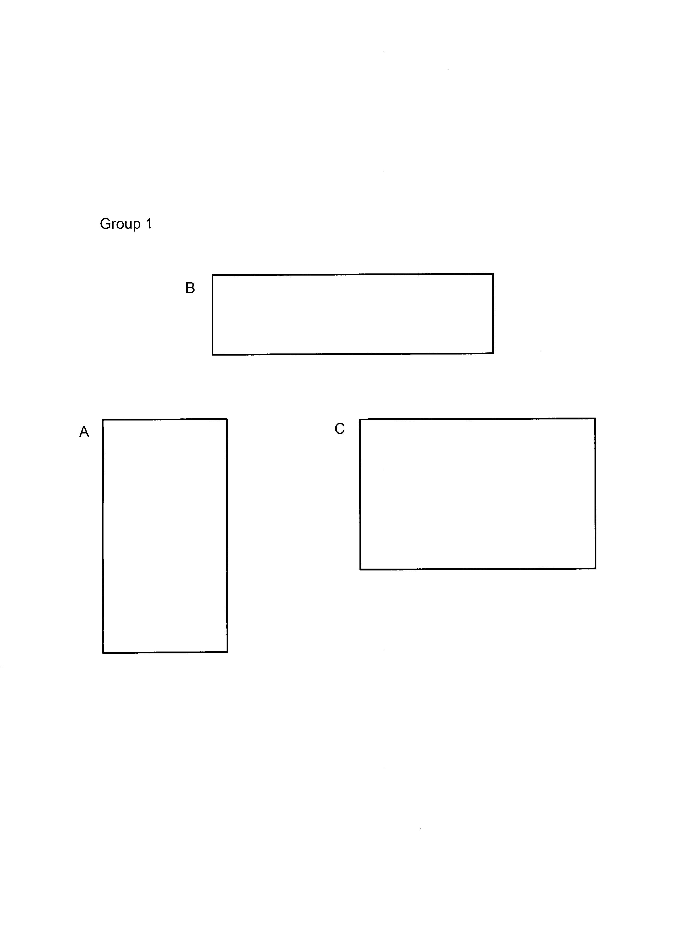
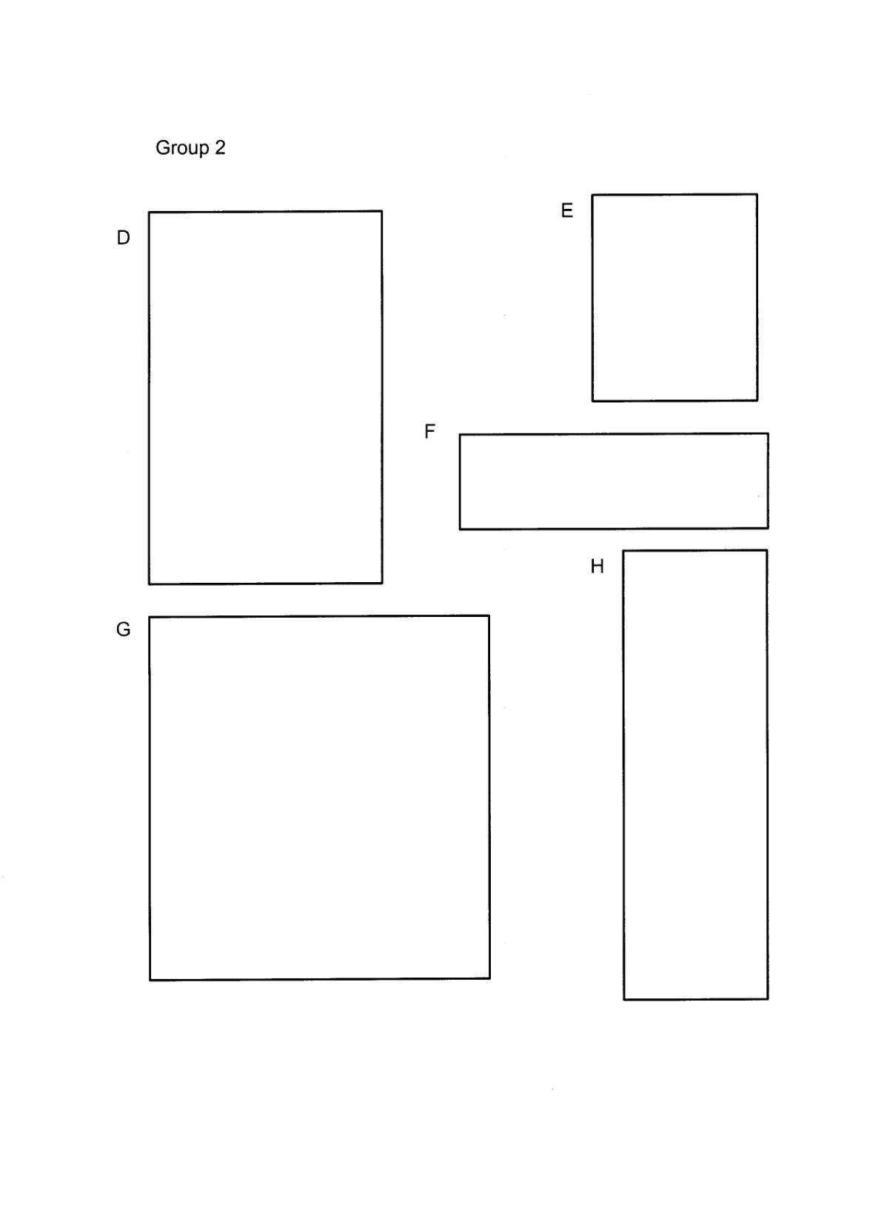

Slide 3
Rectangle | Length | Width | Length/Width
A
B
C
D
E
F
G
H

Slide 4
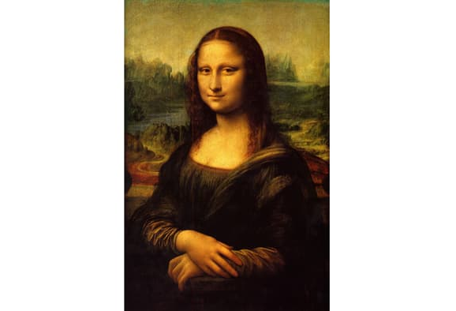

Slide 5
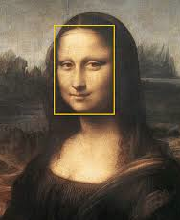
Find the width and length of the rectangle that frames Mona Lisa’s face.

Slide 6
Using your centimeter paper, color a 1x1 square.

Slide 7
Using your centimeter paper, color a 1x1 square to the left of your first square.

Slide 8
Using your centimeter paper, color a 2x2 square above.

Slide 9
Using your centimeter paper, color a ?x? square to the right.

Slide 10
Using your centimeter paper, color a ? x ? square (where?).

Slide 11
Fibonacci

Slide 14
Square added | Length | Width | Ratio: Length to Width
1x1 | 1 | 1
1x1 | 2
2x2
3x3
4x4

Slide 15
What is a ratio?

Slide 16
What is a ratio?
A ratio is a comparison of two quantities.
In this case, we are comparing the length of the rectangle to the width.

Slide 17
What is a ratio?
A ratio is a comparison of two quantities.
In this case, we are comparing the length of the rectangle to the width.
If we continue this pattern, the ratio approaches φ≈1.618

Slide 18
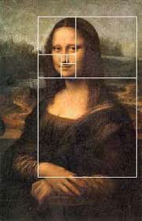

Slide 19
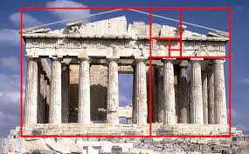

Slide 20
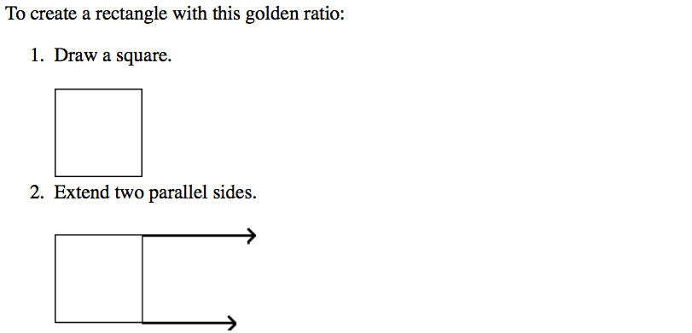
How do we construct a golden rectangle?

Slide 21
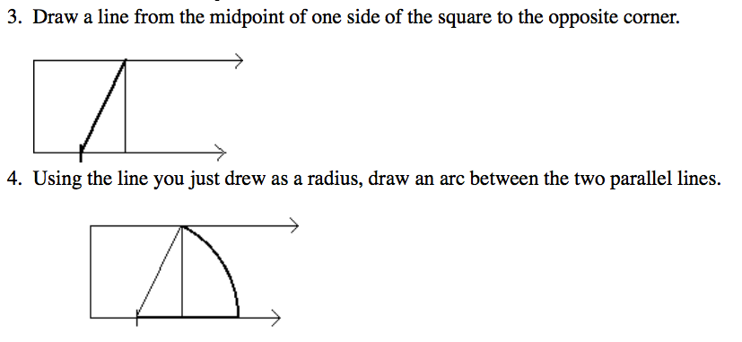

Slide 22
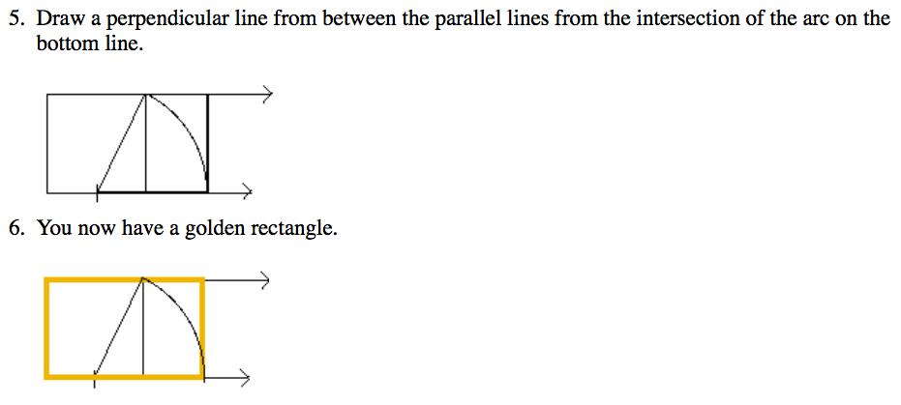

Slide 24
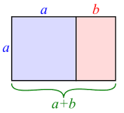
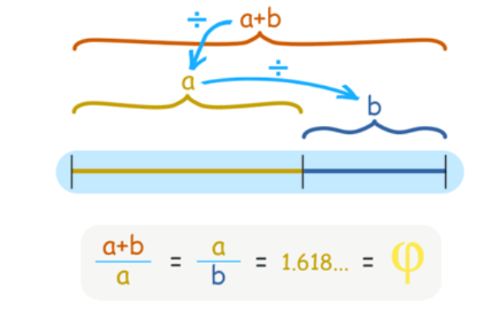

Slide 25
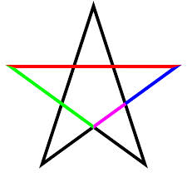
Can you find φ ?

Slide 26
Using your compass, draw an arc for each square with the radius of the side of that square.

Slide 27
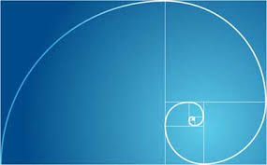

Slide 28
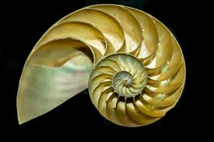

Slide 29
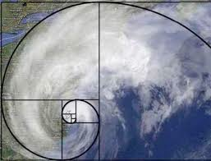

Slide 30
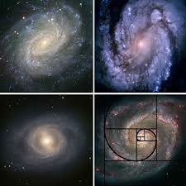

Slide 31
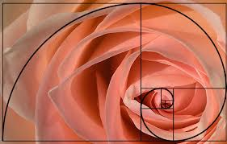

Slide 32
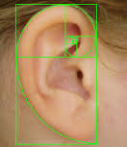

Slide 33
Where else do we find the golden ratio?

Slide 34
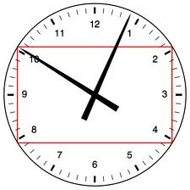

Slide 35
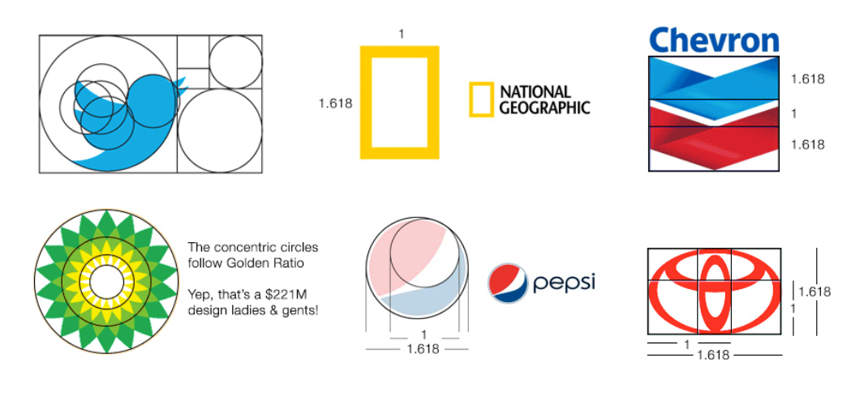

Slide 36
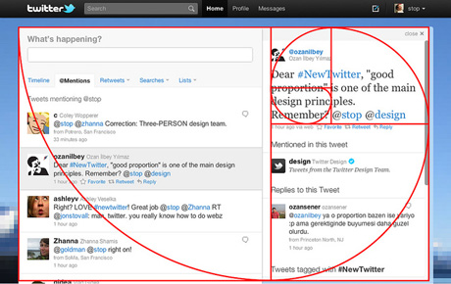

Slide 37
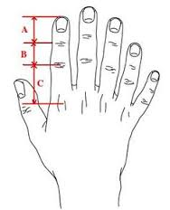
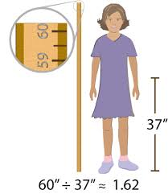
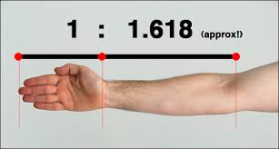
Golden Ratio and the human body

Slide 38
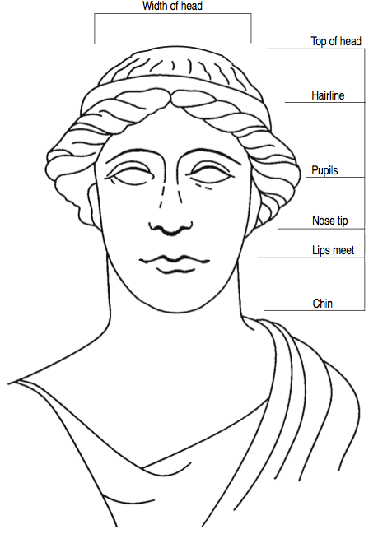
From TI Explorations: Go for the Gold

Slide 39
Examples of the Golden Ratio
On the next pages you will see examples of the Golden Ratio
Many of them have a measurement instrument, called Golden Mean calipers, superimposed over the picture.
This gauge was developed by Dr. Eddy Levin DDS, for use in dentistry and is now used as the standard for the dental profession.
The gauge is set so that the two openings will always stay in the Golden Ratio as they open and close.

Slide 40
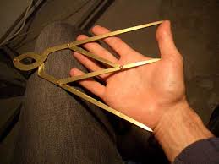

Slide 41
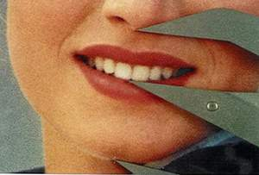
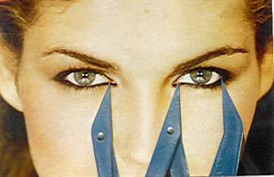

Slide 42
φ also appears in …
Architecture
The Automotive industry
Fashion
General Design
Nature

Slide 43
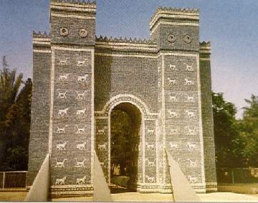
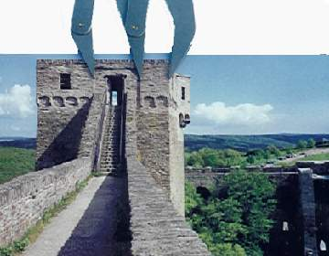
The Bagdad City Gate
The Great Wall of China

Slide 44
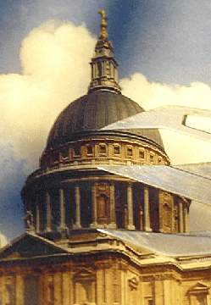
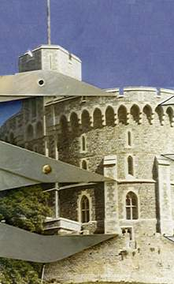
St. Paul’s Cathedral - London
Windsor Castle

Slide 45
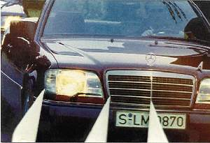

Slide 46
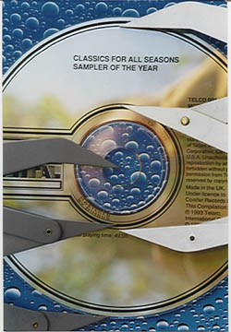

Slide 47
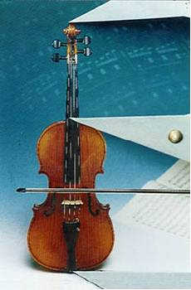

Slide 48
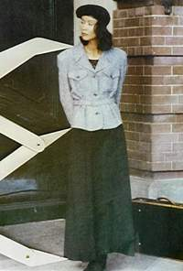

Slide 49
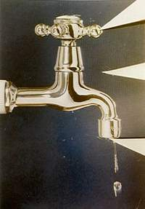

Slide 50
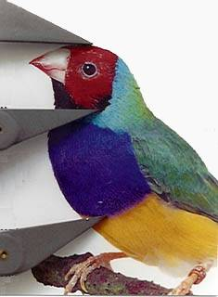

Slide 51
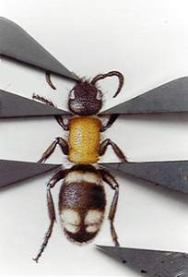

Slide 52
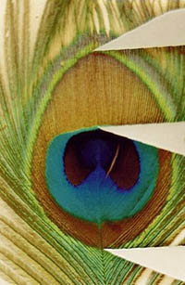

Slide 53
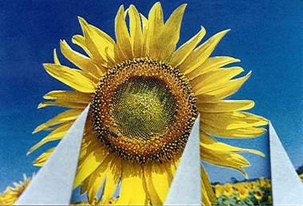

Slide 54
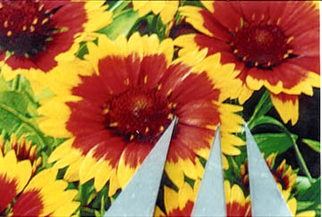

Slide 55
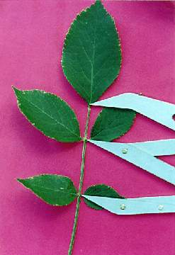

Slide 56
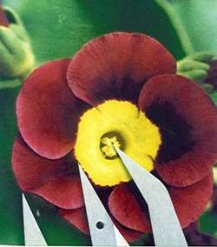

Slide 57

Thank you!
Dr. Eileen Faulkenberry
Associate Professor, Mathematics
Tarleton State University
efaulkenberry@tarleton.edu

